Slide 1

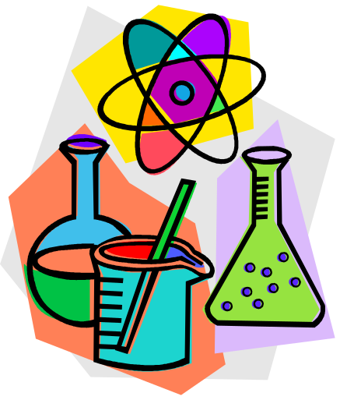
A Matter of Fact
Mixtures, Elements and Compounds

Slide 2
Mixtures, elements, compounds
Scientists like to classify things.
One way that scientists classify matter is by its composition.
Ultimately, all matter can be classified as mixtures, elements and compounds.

Slide 3
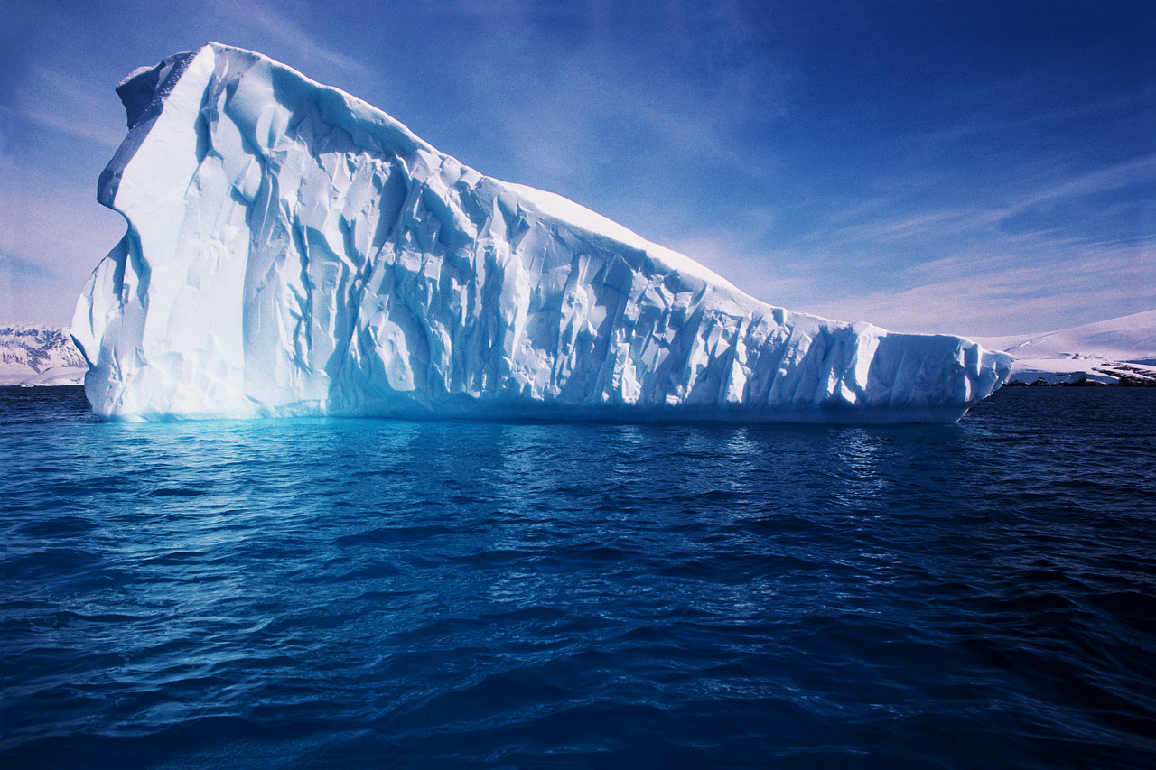
Why isn’t it a good idea to classify matter by its phases?
Because one kind of substance can exist in more than one phase – such as H20. And matter changes phases rather easily.

Slide 4



Why isn’t matter classified according to its physical characteristics, such as color?
Scientists wouldn’t find it very useful to group gold, sunflowers, and the sun together.

Slide 5
Scientists ask themselves these questions?
  Is the matter uniform throughout?
  Can it be separated by physical means?
  Can it be separated by chemical means?

Slide 6
By asking these questions scientists can classify matter into:
Mixtures – two or more substances that are not chemically combined with each other and can be separated by physical means. The substances in a mixture retain their individual properties.
  Solutions – a special kind of mixture where one substance dissolves in another.
Elements – simplest form of pure substance. They cannot be broken into anything else by physical or chemical means.
Compounds – pure substances that are the unions of two or more elements. They can be broken into simpler substances by chemical means.

Slide 7
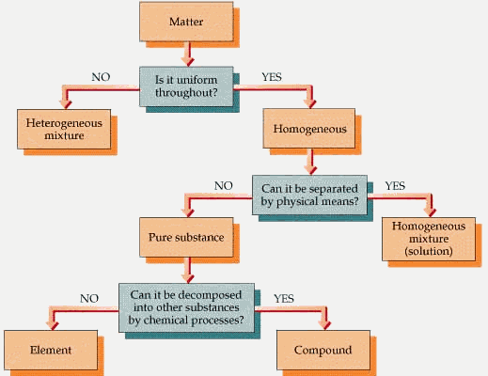

Slide 8
Is it uniform throughout?
If the answer is no, the matter is a heterogeneous mixture.
  Considered the “least mixed.”
  Does not appear to be the same throughout.
  Particles are large enough to be seen and to be separated from the mixture.

Slide 9
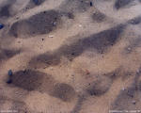

Examples of heterogeneous mixtures
Sand and pebbles
Oil and water
Powdered iron and powdered sulfur

Slide 10

Granite is a heterogeneous mixture.

Slide 12
Is it uniform throughout?
If the answer is yes, the matter is homogeneous (looks the same throughout).
That leads us to another question.

Slide 13
Can it be separated by physical means?
If the answer is yes, the matter is a homogeneous mixture or solution.

Slide 14
Homogeneous Mixtures
A mixture that appears to be the same throughout.
It is “well mixed.”
The particles that make up the mixture are very small and not easily recognizable.

Slide 15



Examples of homogeneous mixtures
Milk, toothpaste, and mayonnaise are homogeneous
mixtures. They are also colloids.

Slide 16


Colloids
In a colloid the particles are mixed together but not dissolved.
The particles are relatively large and are kept permanently suspended.

Slide 17

Colloids
A colloid will not separate upon standing.
The particles are constantly colliding, and this allows a colloid to scatter light – thus colloids often seem cloudy.

Slide 18


Slide 19
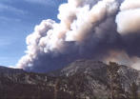

Slide 20
Solutions
A solution is a type of homogeneous mixture formed when one substance dissolves in another.
It is the best mixed of all mixtures.
A solution always has a substance that is dissolved and a substance that does the dissolving.
The substance that is dissolved is the solute and the substance that does the dissolving is the solvent.

Slide 21

Ocean water is a solution

Slide 22

The universal solvent: Water

Slide 23
Water as a solvent
Many liquid solutions contain water as the solvent.
Ocean water is basically a water solution that contains many salts.
Body fluids are also water solutions.

Slide 24
Types of solutions
Solute
Solvent
Example
Gas | Gas | Air (oxygen in nitrogen)
Gas | Liquid | Soda water (carbon dioxide in water)
Solid | Liquid | Ocean water (salt in water)
Solid | Solid | Gold jewelry (copper in gold)
Metals dissolved in metals are called alloys.

Slide 25
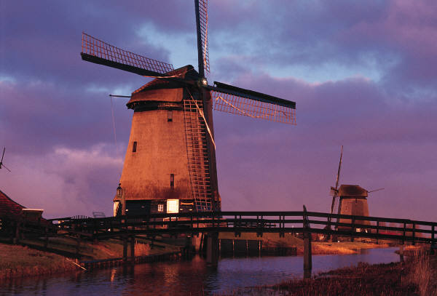
Air is a solution of oxygen and other gases dissolved in nitrogen

Slide 26


Alloys
Stainless steel is a mixture
of iron and chromium.
Brass is an alloy of copper
and zinc.

Slide 28
Can it be separated by physical means?
If the answer is no, the matter is a pure substance.
  An element
  Or a compound

Slide 29
Elements
Elements are the simplest pure substance.
  An element can not be changed into a simpler substance by heating or any chemical process.
The smallest particle of an element that has the properties of that element is called an atom.
  An atom is the basic building block of matter.
There are more than one hundred known elements in the universe listed on the periodic table of elements.
  These elements combine in such a way to create millions of compounds.

Slide 30

Elements
All elements are made of atoms.
Atoms of the same element are alike.
Atoms of different elements are different.

Slide 31

Elements
In 1813, a system of representing elements with symbols was introduced.
  Each symbol consists of one or two letters.
  Two letters are needed for a chemical symbol when the first letter of that element’s name has already been used.

Slide 32
Common Elements
Aluminum | Al
Bromine | Br
Calcium | Ca
Carbon | C
Gold | Au
Helium | He
Hydrogen | H
Nitrogen | N

Slide 33

Compounds
Compounds are also pure substances.
But compounds are made from more than one element.
Water is a compound.
Water can be broken down into simpler substances – hydrogen and oxygen.

